Slide 1
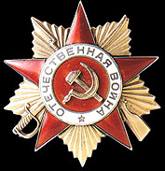
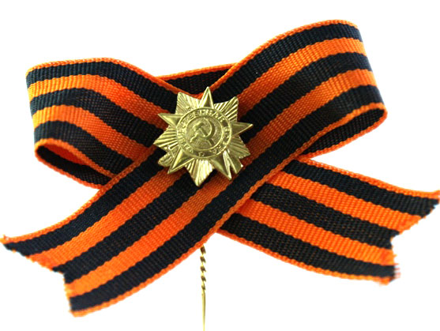
Sinitsina Anna, school 51, Nizhny Novgorod
Years of the Great Patriotic War are the most terrible years. But our people defeated the enemy and we are proud of our veterans!

Slide 2
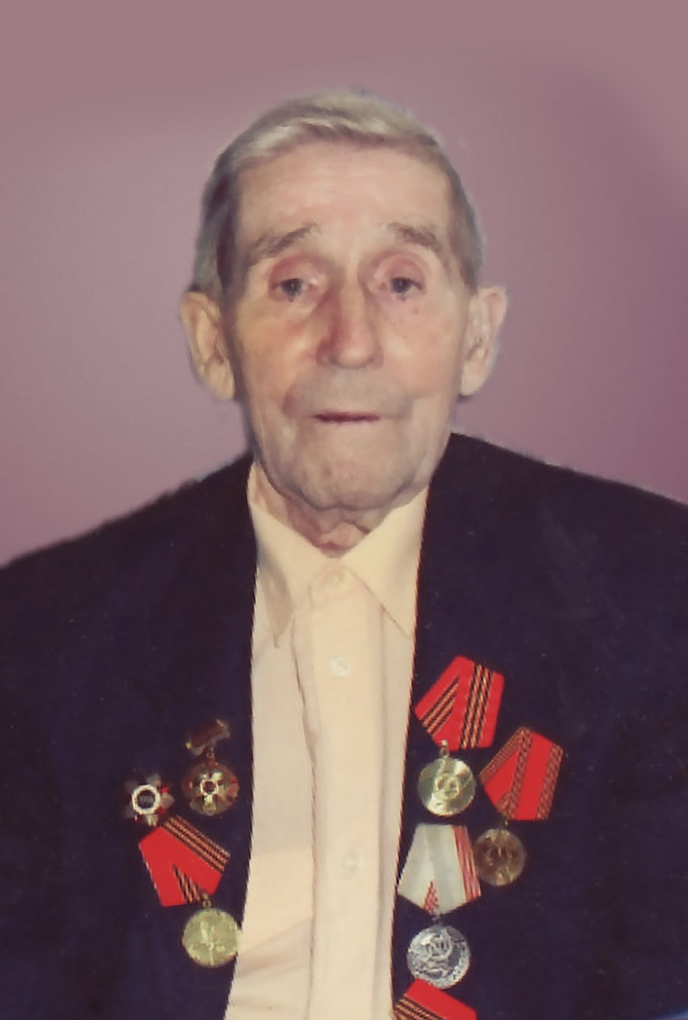
Let me introduce my great-grandfather. His name is Tarasov Pavlin Vasilyevich.
Now he is alive, he is 91 years old!

Slide 3
My grandfather went to the front when the war began. His job was to coordinate the work of anti-aircraft guns.

Slide 4
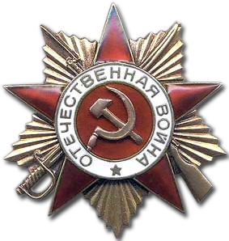
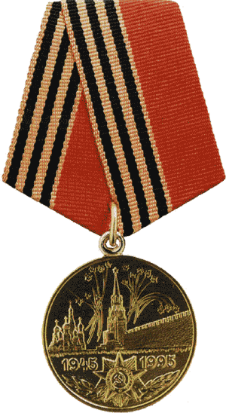
Pavlin Vasilyevich was awarded the Order of the Great Patriotic War, the medal "50 Years of Victory in the Great Patriotic War and others.

Slide 5
I am proud of my great-grandfather, because he is one of those who saved our country from the enemy. I love my great-grandfather very much and never forget him.

